Slide 1

ANALYSIS AND VISUALIZATION OF P&L DATA IN EXCEL
Comprehensive Analysis of Financial Performance
Rutvik Trivedi

Slide 2
Project Overview
FINANCIAL ANALYSIS OVERVIEW
Problem Statement
Understanding the Data
Data Cleaning and P&L Structure
Profitability Margin Calculations
Data Visualizations
Insights

Slide 3
Problem Statement
FINANCIAL ANALYSIS OVERVIEW
Detailed P&L Table
Prepare an Excel P&L table from raw data, focusing on revenue and essential P&L items leading to EBIT.
Financial Performance Insights
Provide insights into Adidas’ financial performance covering 2019 to 2023, emphasizing revenue growth, profitability margins, and segment contributions.
Revenue Analysis
Break down revenue trends, highlighting growth patterns and factors impacting Adidas' top-line performance.
Profitability Evaluation
Evaluate profitability margins, including net profit margin, gross profit margin, and operating profit margin over the specified period.

Slide 4
Understanding the DATA
FINANCIAL ANALYSIS OVERVIEW
Raw Financial Data Extraction
Extracted detailed financial information from Bloomberg files to initiate analysis.
Constructing P&L Statement
Utilized revenue and expense lines to build a comprehensive Profit and Loss statement.

Slide 5
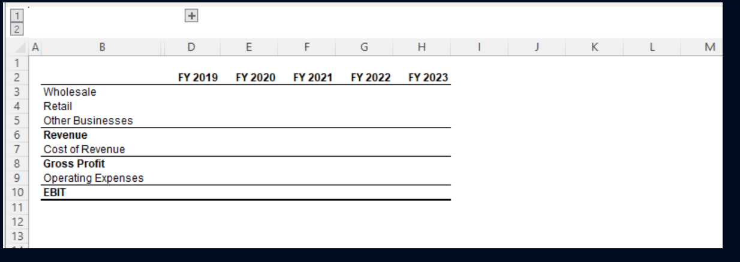
P&L Structure
FINANCIAL ANALYSIS OVERVIEW

Slide 6
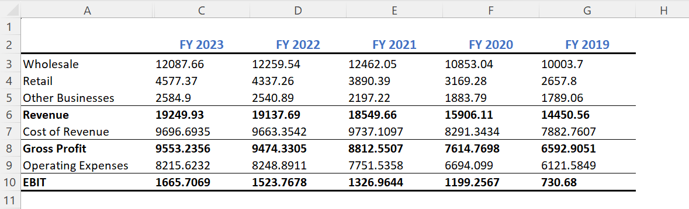
Data Extraction
FINANCIAL ANALYSIS OVERVIEW
Using the INDEX and MATCH functions, I populated the P&L statement by extracting relevant data from the raw Bloomberg files.

Slide 7
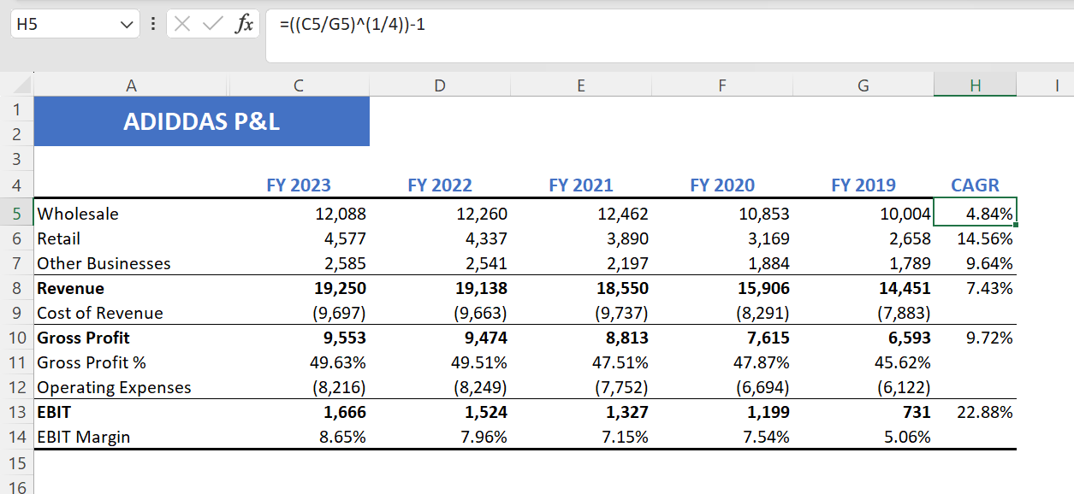
PROFITABILITY MARGINS CALCULATION
FINANCIAL ANALYSIS OVERVIEW
3
1
2

Slide 8
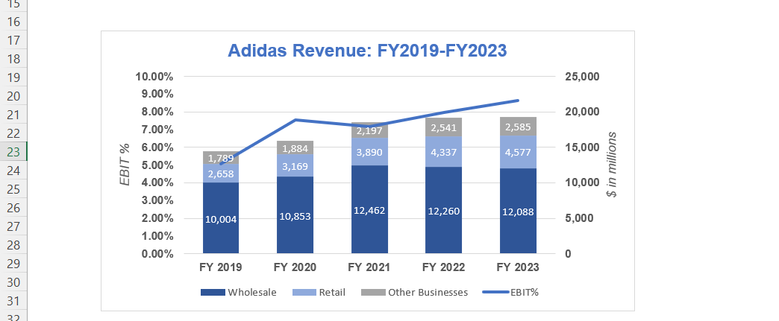
Data Visualization
FINANCIAL ANALYSIS OVERVIEW

Slide 9
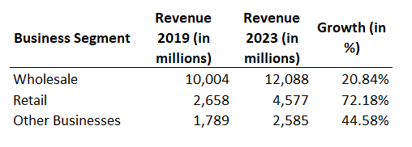
Data Visualization
FINANCIAL ANALYSIS OVERVIEW

Slide 10
How Did the Company’s Performance Measure Up During This Period?
FINANCIAL ANALYSIS OVERVIEW
Total revenue increased from $14,475.66 million in 2019 to $19,249.93 million in 2023
Adidas showed significant improvement in its financial performance between 2019 and 2023.
Were They Able to Accelerate Revenue Growth at a Healthy Rate?
Yes, Adidas was able to accelerate revenue growth at a healthy rate.
The overall revenue grew by approximately 33% over the five-year period, with a CAGR of around 7.28%.
This growth rate is indicative of a strong and consistent expansion of the company’s market presence and product offerings.

Slide 11
Which Business Segment Registered the Fastest and Slowest Growth?
FINANCIAL ANALYSIS OVERVIEW
Fastest Growing Segment: The Retail segment registered the fastest growth, increasing from $2,658 million in 2019 to $4,577 million in 2023. This represents a substantial growth rate of 72.18%.
Slowest Growing Segment: The Wholesale segment showed the slowest growth, albeit still positive, increasing from $10,004 million in 2019 to $12,088 million in 2023, which is a 20.84% growth rate.
Other Businesses: This segment also saw significant growth, increasing from $1,789 million in 2019 to $2,585 million in 2023, reflecting a 44.58% growth rate.
Profitability: Improved EBIT margins from 7.0% to 8.0% indicate effective management and operational efficiency.

